Slide 1
How to setup Google Colab

Slide 2
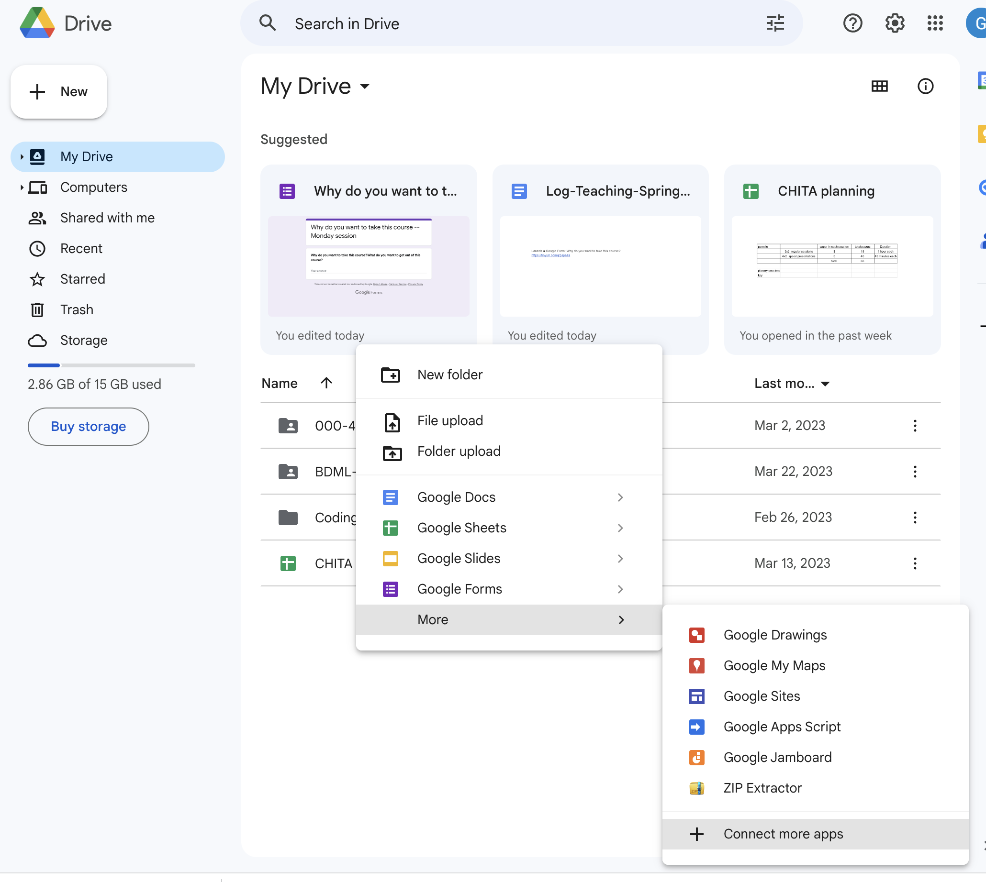

Slide 3
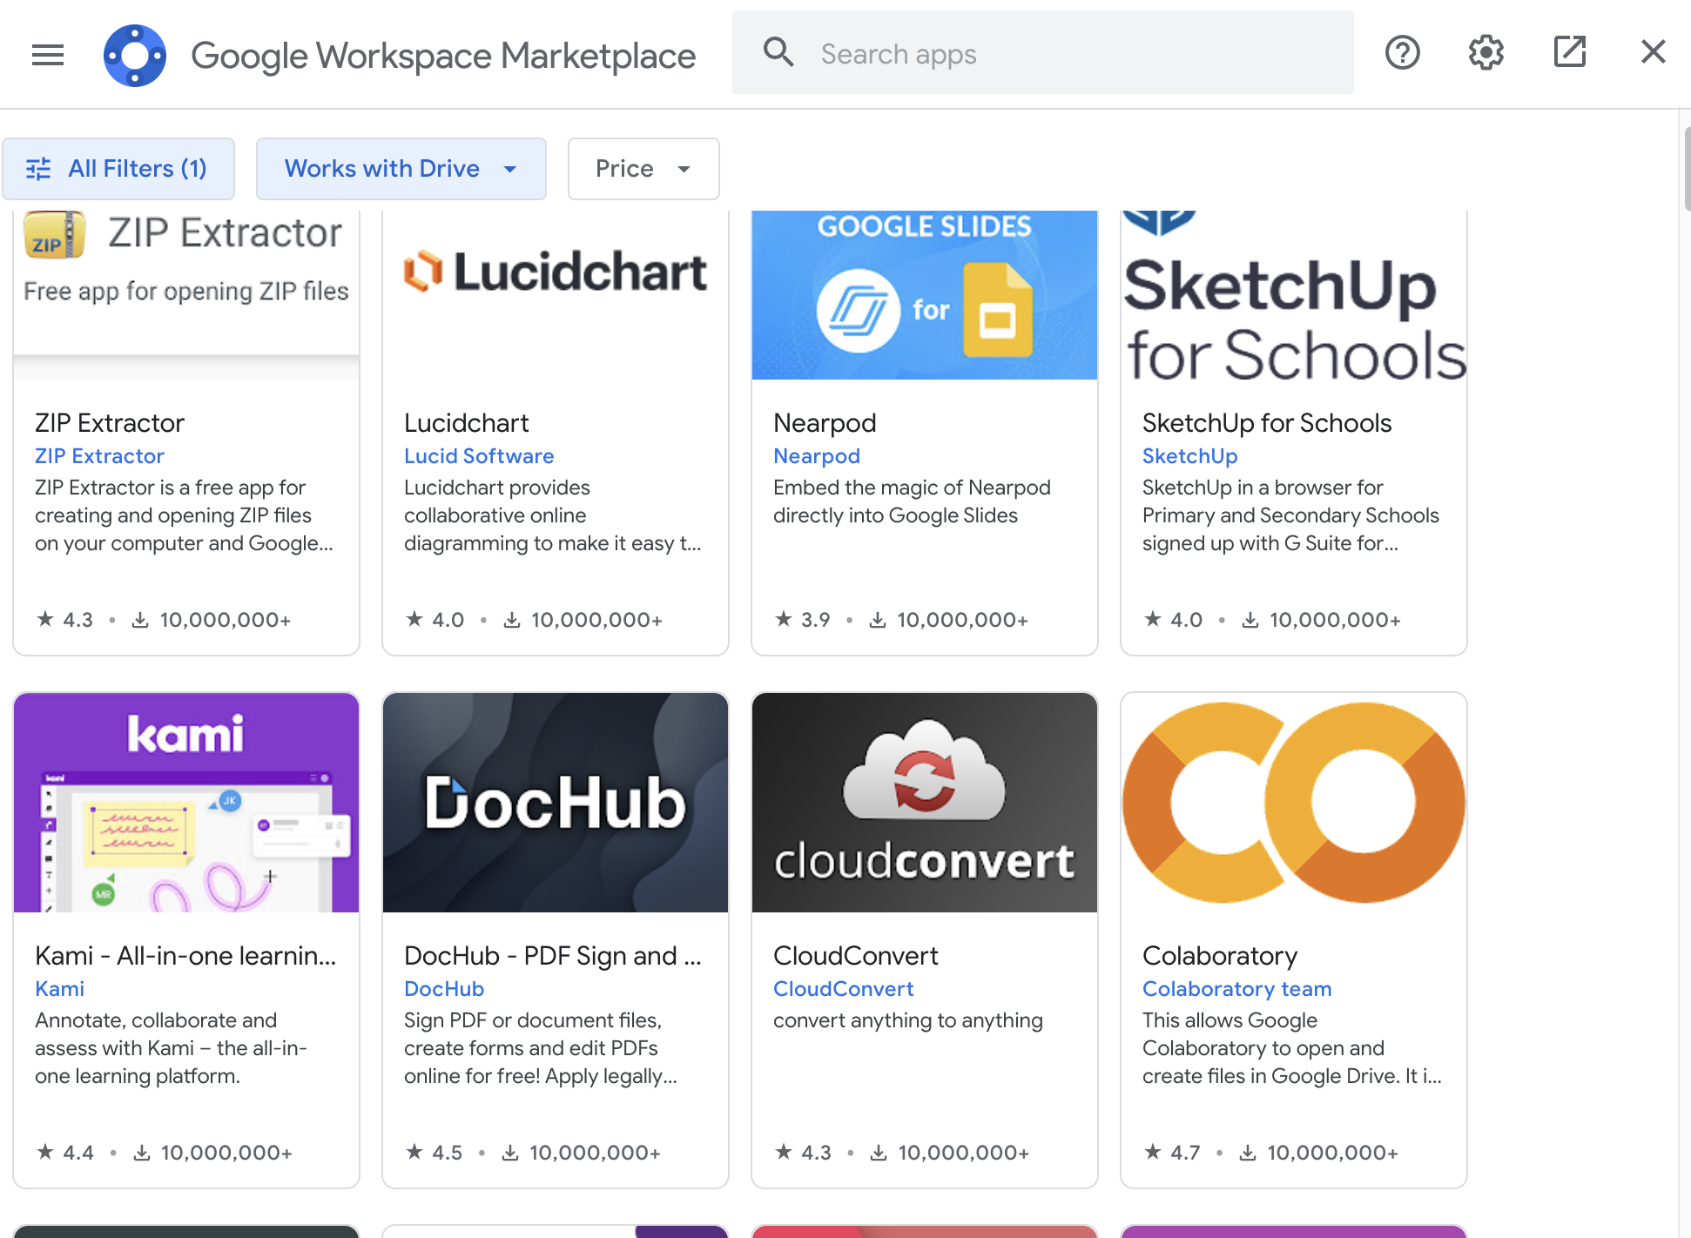

Slide 4
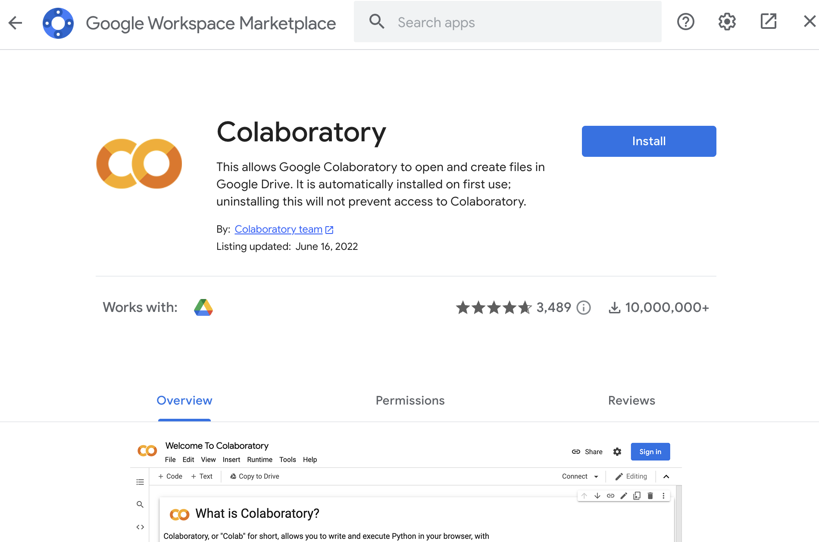

Slide 5
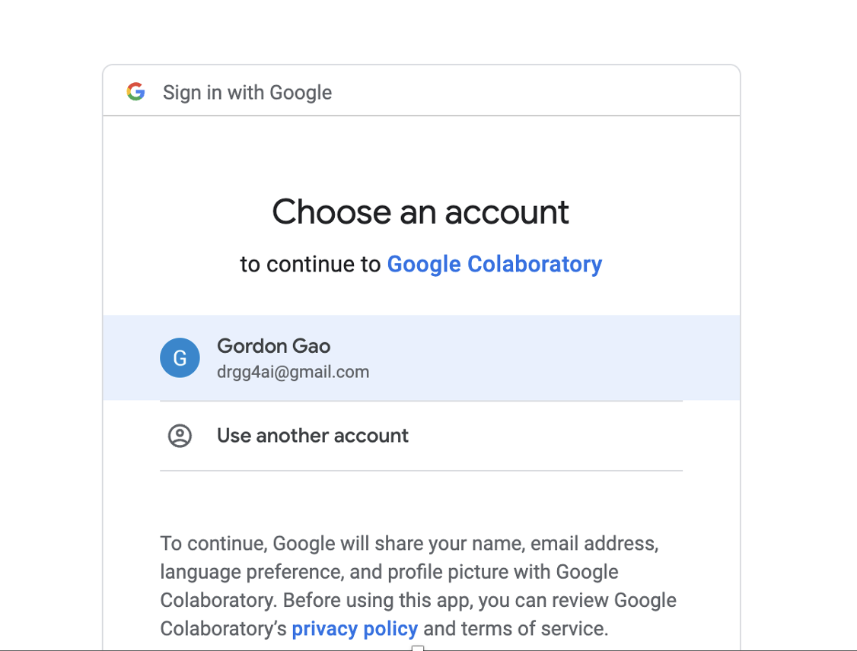
Make sure you consistently use the same account

Slide 6
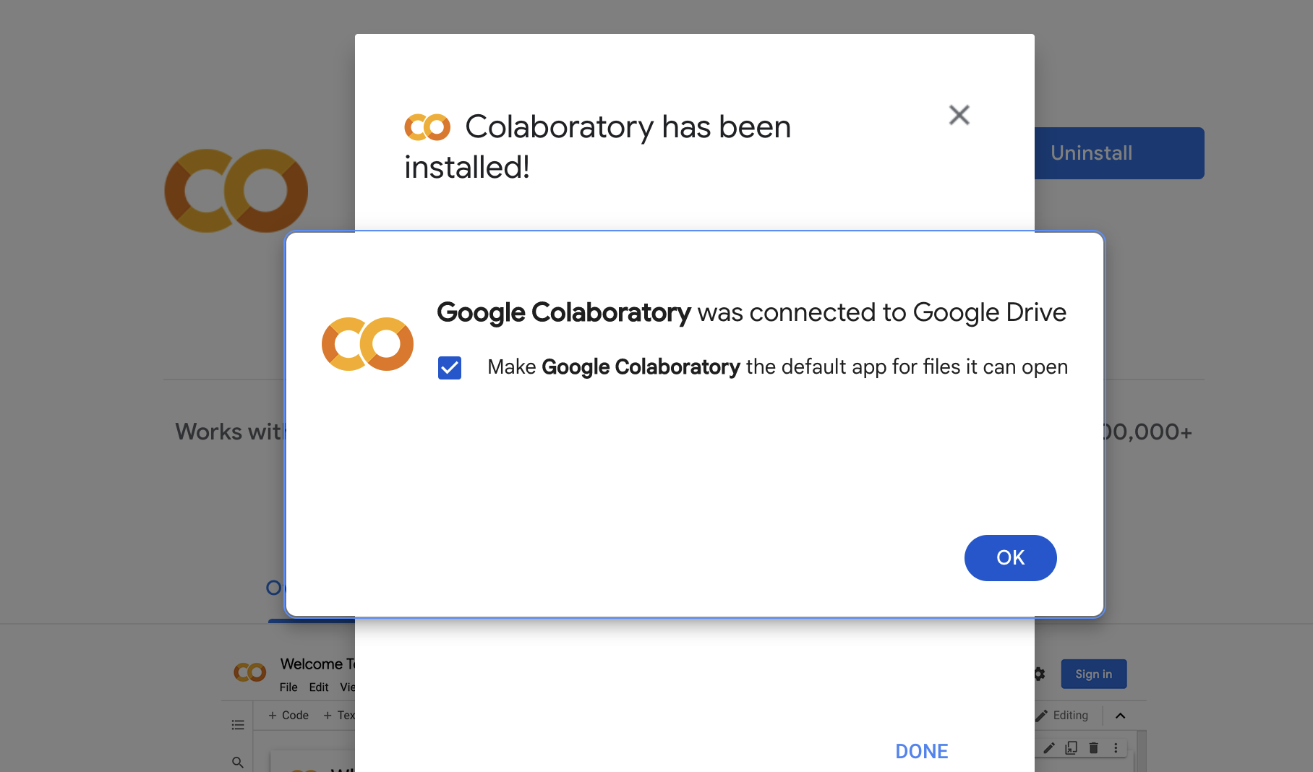

Slide 7
topics
Sections and Table of Contents
Collapse cells in a section
Data download
Clear output
Reset runtime

Slide 8
Sections and Table of Contents

Slide 9
Collapse cells in a section

Slide 10
Data download

Slide 11
Clear output

Slide 12
Reset runtime

Slide 13
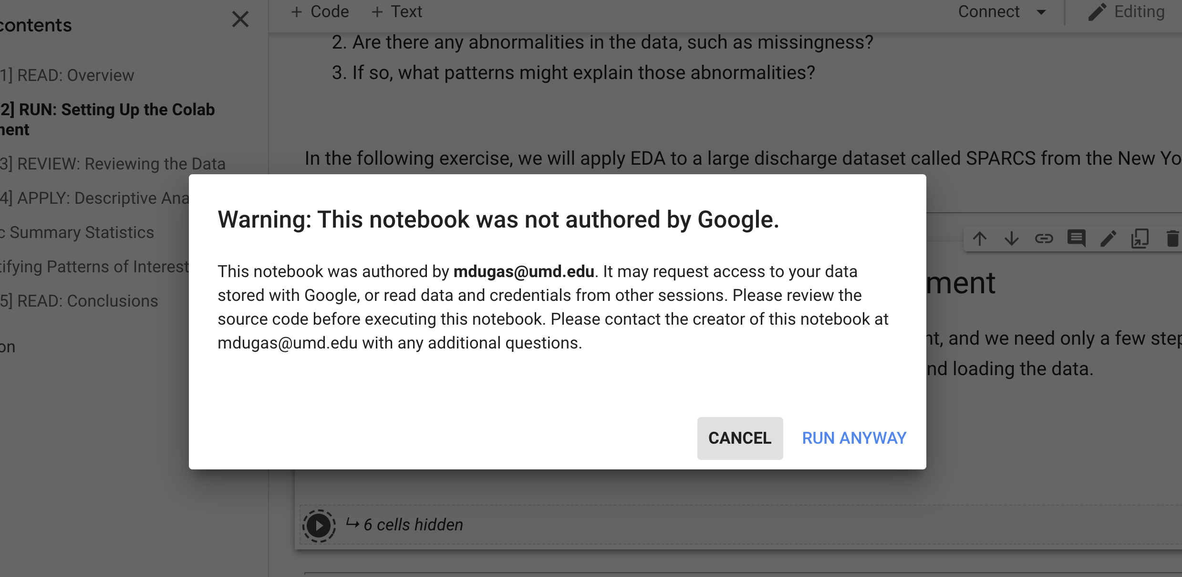

Slide 14
